Slide 1
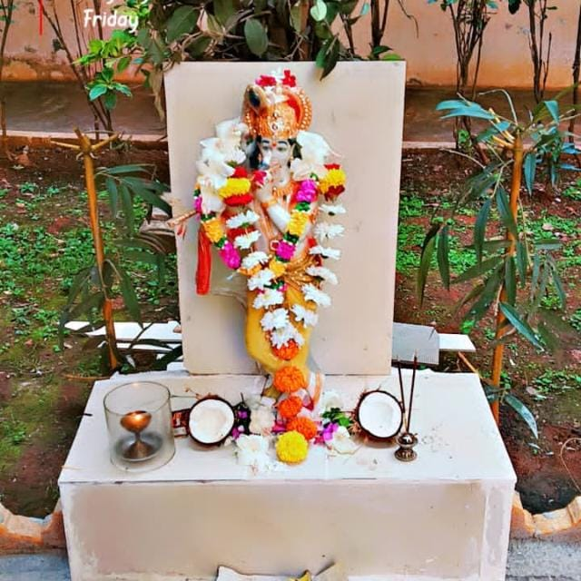
DIVINE SOLUTION FOR CLEANLINESS Installation of Lord Krishna Idol
at IT Park, Hubballi
An Innovative Initiative by Security Team
Supported by
Vijay Dev Sir & Mahantesh Bannimarad Sir

Slide 2
THE CHALLENGE - Aniyamitha Anachara
THE CHALLENGE: Unhygienic Practices at IT Park Premises
Points:
People littering garbage everywhere Gutkha,
Paan chewing and spitting on walls,
corridors & lobby Open urination in isolated areas Created unhygienic environment & bad image

Slide 3
FAILED ATTEMPTS TO CONTROL
PREVIOUS EFFORTS - ALL CONVENTIONAL METHODS FAILED
Points:
Pasted "No Spitting" Notice Boards at spitting zones People tore the notice boards, Applied Lime (Sunna) on spitted walls Cleaned repeatedly.
but people continued spitting Impossible to control.

Slide 4
THE DIVINE IDEA
INNOVATIVE IDEA: Divine Presence to Maintain Cleanliness
Points:
Thought: If God Murthy is present, people will have Bhaya-Bhakti Due to devotion.
They will stop spitting & littering Idea discussed with respected Manager Shri Vijay Dev Sir.
Sir appreciated and gave permission immediately.

Slide 5
WHY LORD KRISHNA?
Perfect for Open Garden Concept
Points:
If we install any God, daily Pooja is mandatory Our intention is Open Garden Concept with Clean & Hygienic purpose Lord Krishna symbolizes Love, Peace & Cleanliness Hence decided to install Krishna Vigraha
SUPPORT & CONTRIBUTION FOR NOBLE CAUSE
Manager Sir guided to contact Training Centre Head Shri Mahantesh Bannimarad. He happily agreed to contribute money for Krishna Murthy Our staff visited shop, selected beautiful Krishna Idol Brought with devotion - Example of Teamwork

Slide 6
FINAL RESULT - BEFORE vs AFTER
TRANSFORMATION COMPLETE: 100% SUCCESS
POINTS:
BEFORE: Gutkha stains, Garbage, Bad smell
AFTER: No spitting, Clean & Divine, People show respect, Positive environment.
RESULT: Divine Fear Worked Where Notices Failed.
Blessings from Management, Contribution from Training Centre, Created with Devotion by Security Team
JAI SHRI KRISHNA

Slide 7
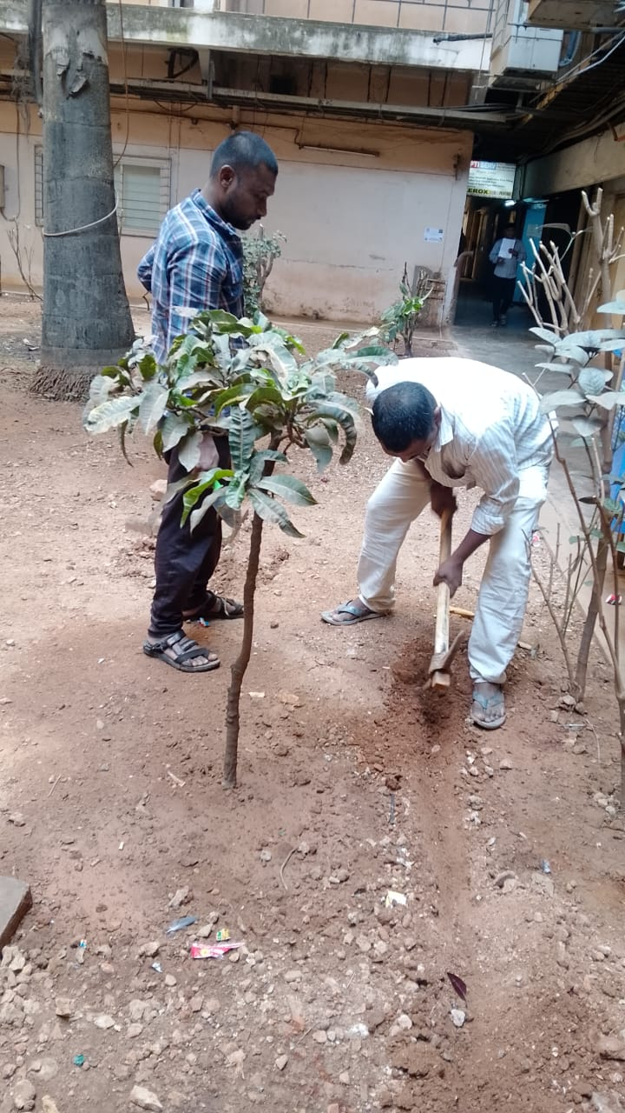
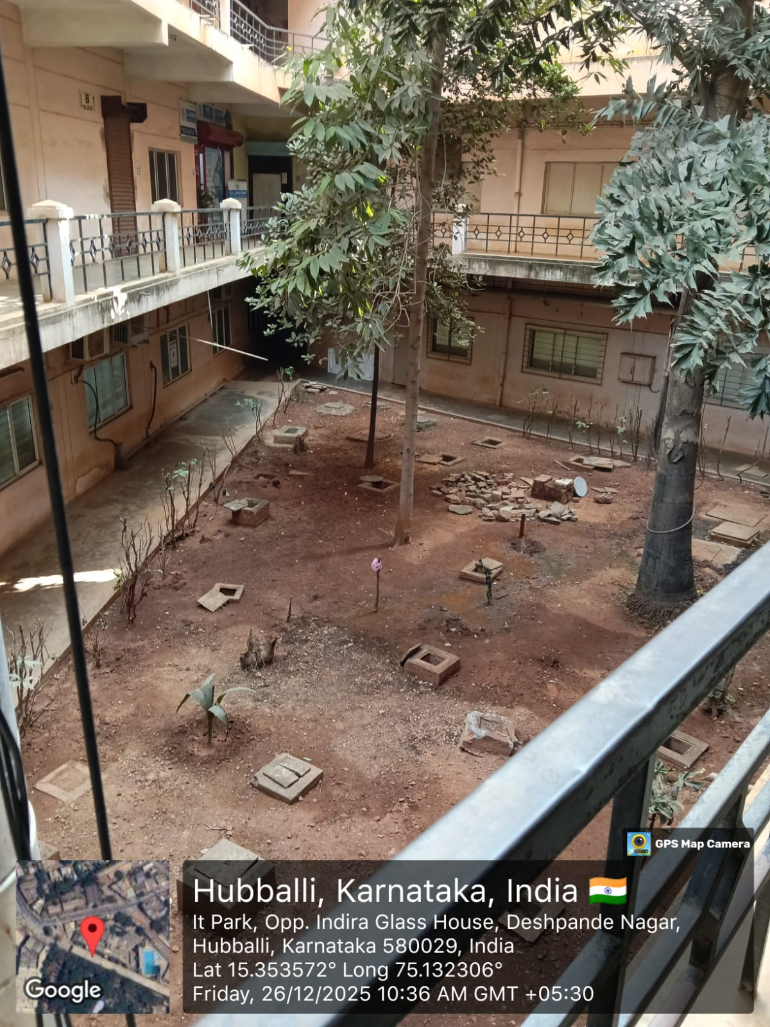
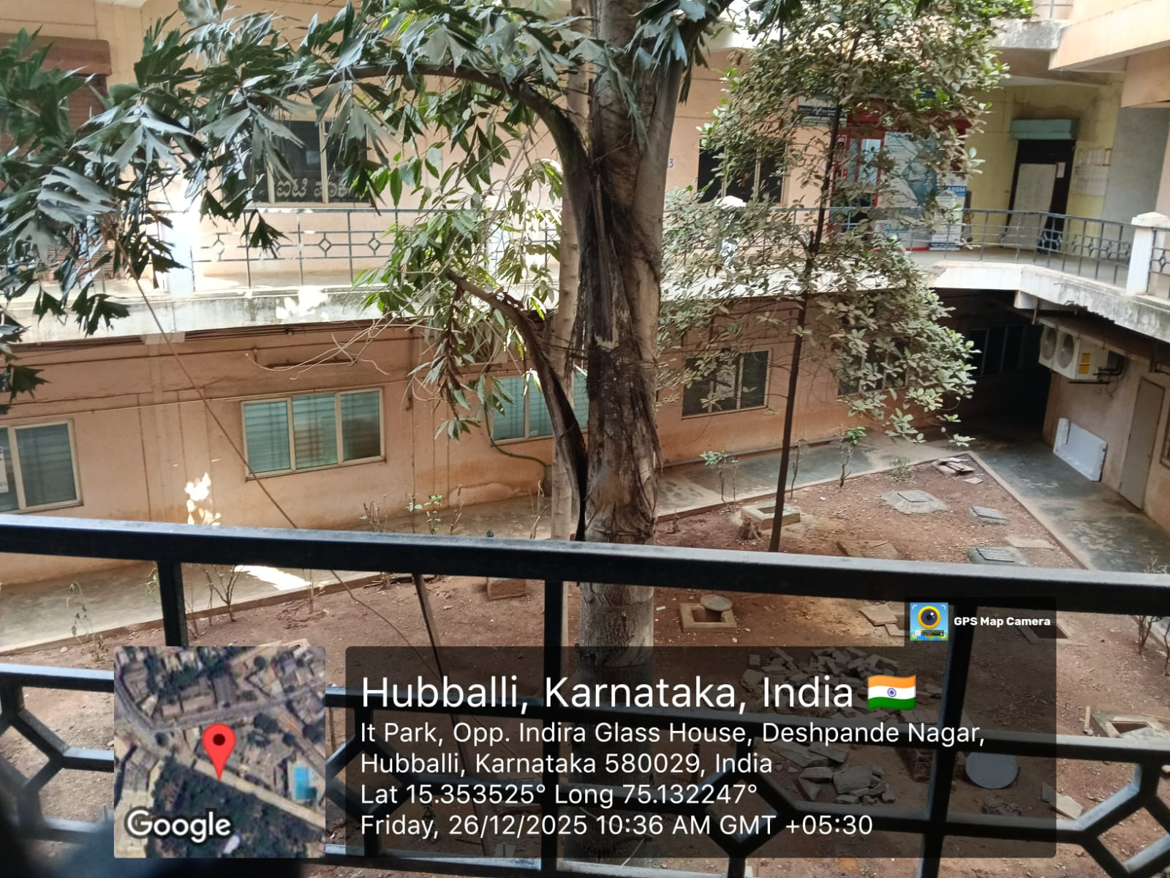
INITIAL STAGE: Condition of the Area Before Development of
Shri Krishna Garden

Slide 8
BEFORE - THE UNUTILIZED & UNCLEAN SPACE
This open area inside IT Park Hubballi was completely unused and filled with waste & dust.
• The place was unclean, unhygienic and was being misused for spitting and littering.
• Our Security Team identified this neglected area and decided to transform it.
• Initiative taken to clean the area and develop it into a Divine Shri Krishna Garden with plantation and seating.

Slide 9
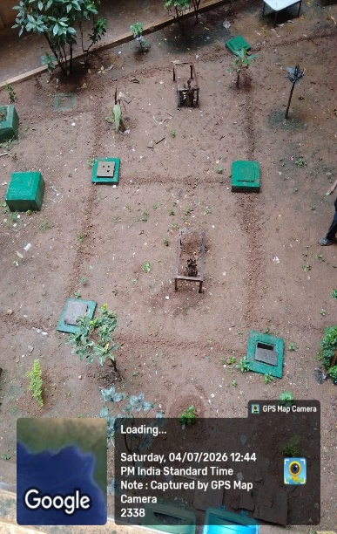
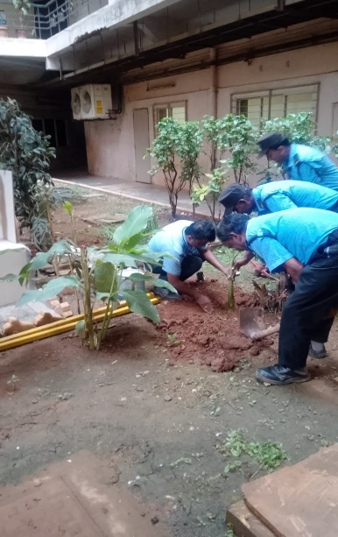
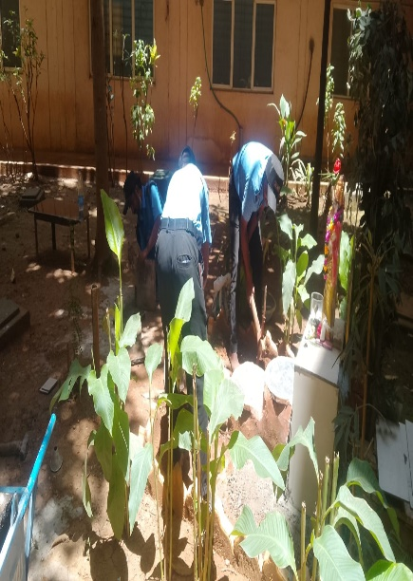
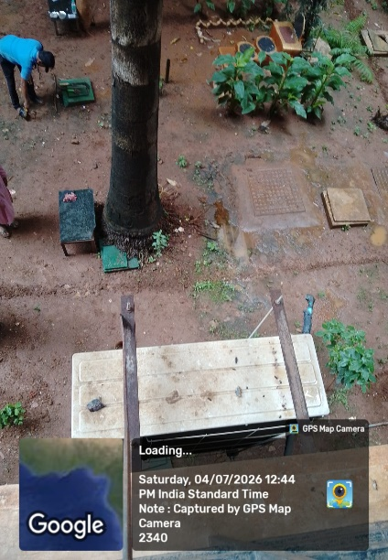
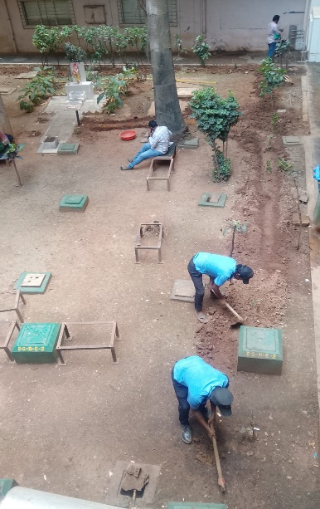
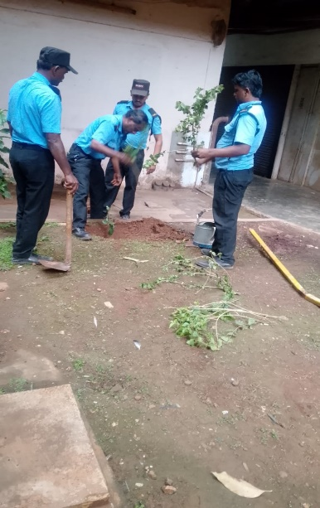
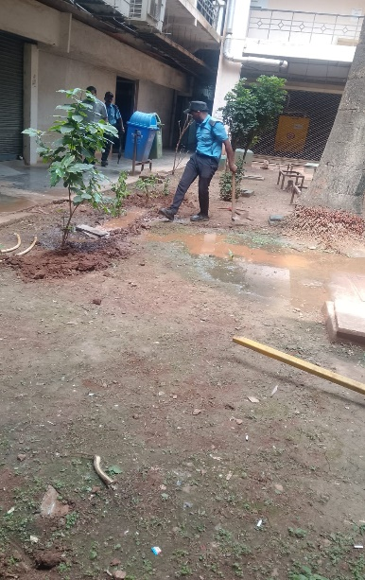
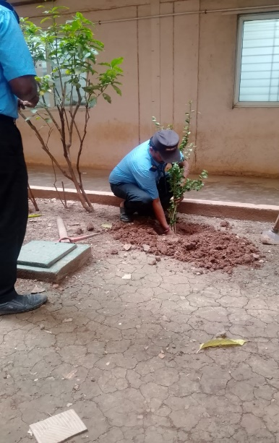
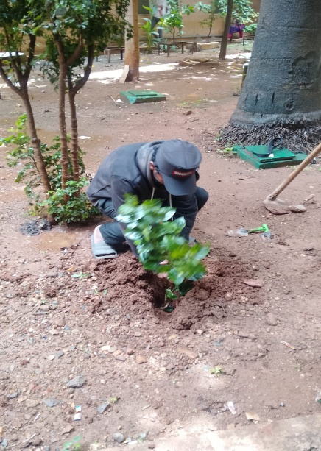
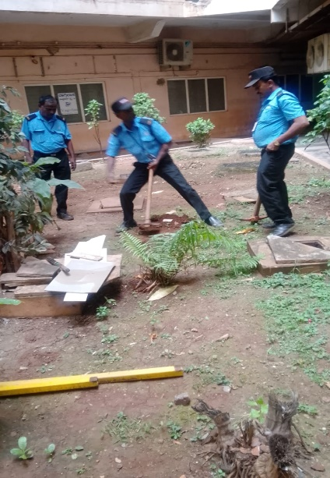
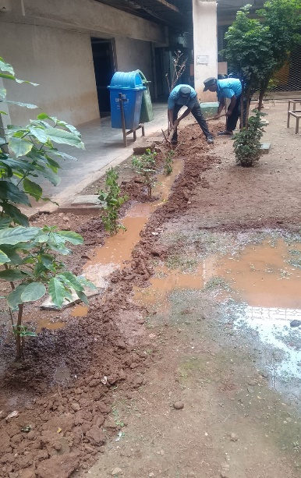
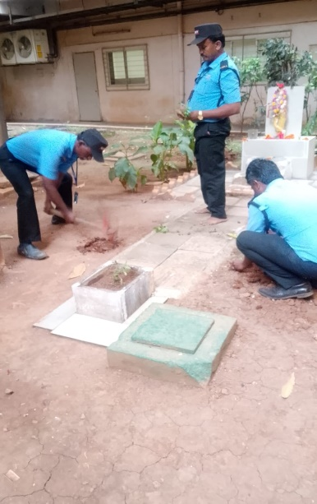
GREEN INITIATIVE: Security Guards Developing Shri Krishna Garden with Own Hands

Slide 10
PLANTATION DRIVE BY SECURITY TEAM
• After cleaning the unused area, our Security Team started developing the Shri Krishna Garden.
• Security guards themselves digging pits, planting saplings with devotion and dedication.
• More than 50+ plants planted around Shri Krishna Sannidhana to create a green & divine environment.
• Varieties Planted: Banana Trees, Flowering Plants, Show Plants & Ornamental Plants for beautification and greenery.
• This is not just duty, but Seva - Transforming a waste land into a beautiful green & divine garden with own hands.

Slide 11
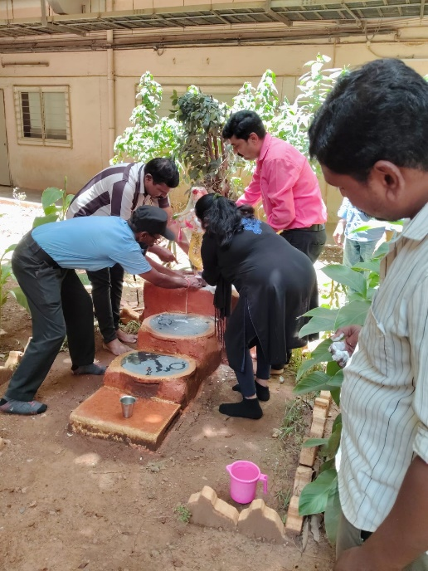
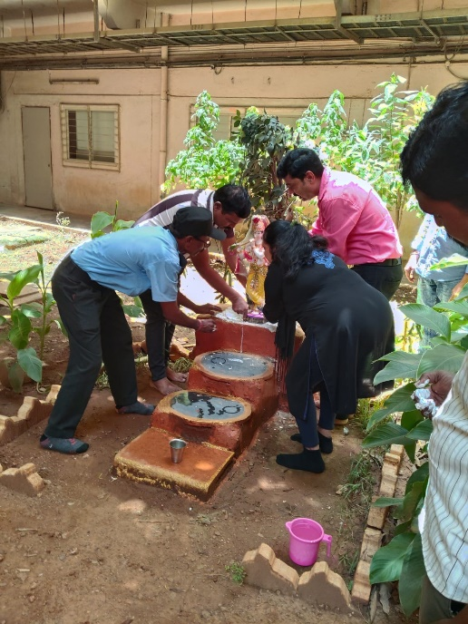
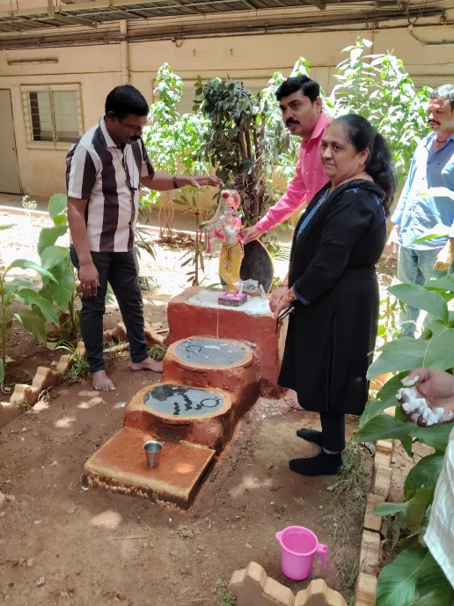
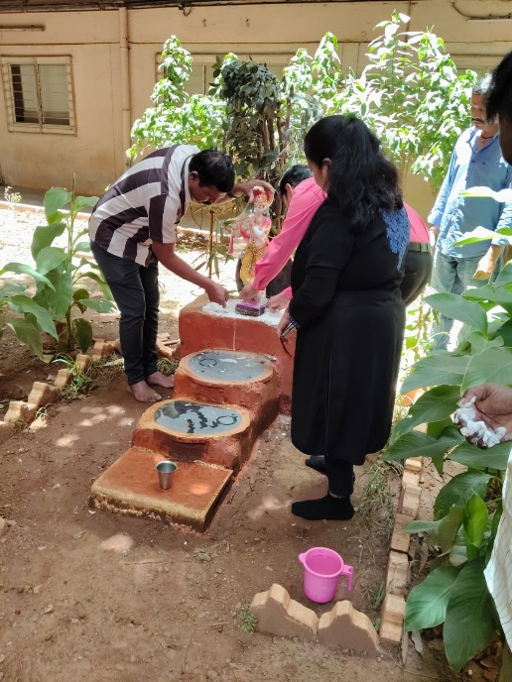
INSTALLATION CEREMONY AT IT PARK HUBBALLI
Idol installed with devotion at IT Park Pratishthapane
done by Manager Vijay Dev Sir & Training Centre Head Mahantesh Bannimarad Sir

Slide 12
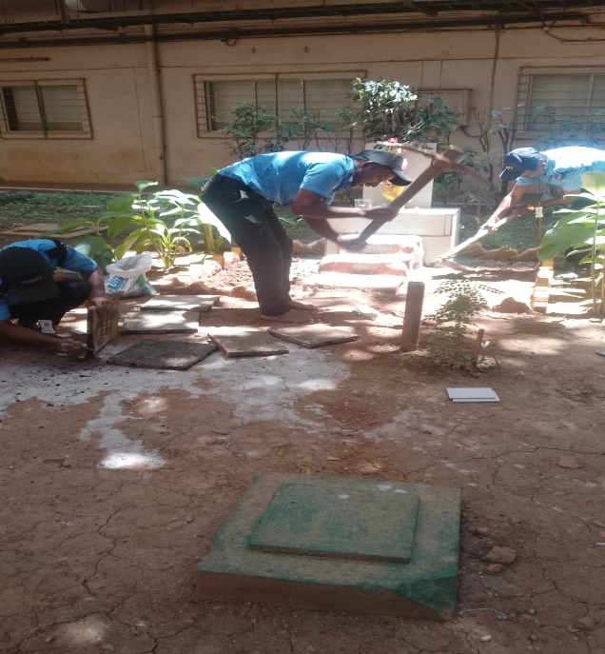
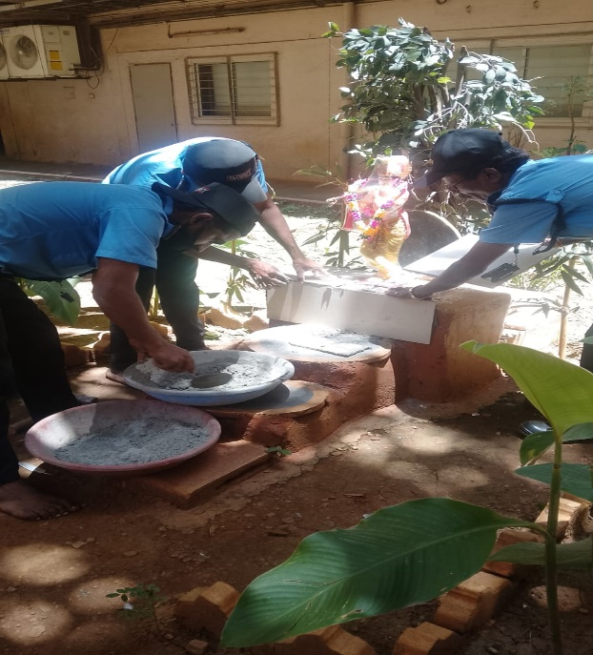
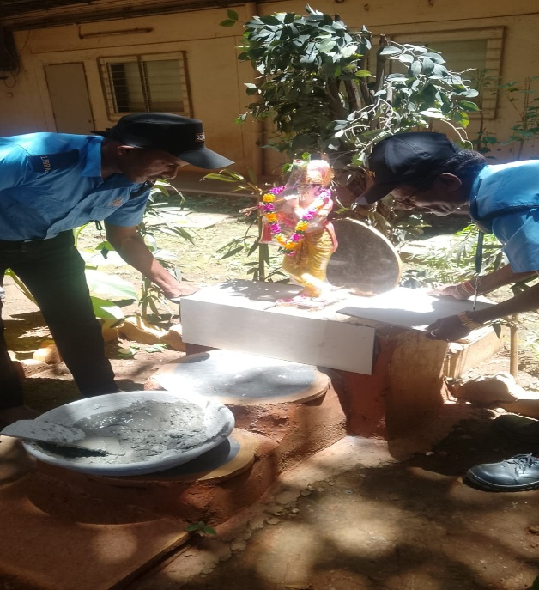
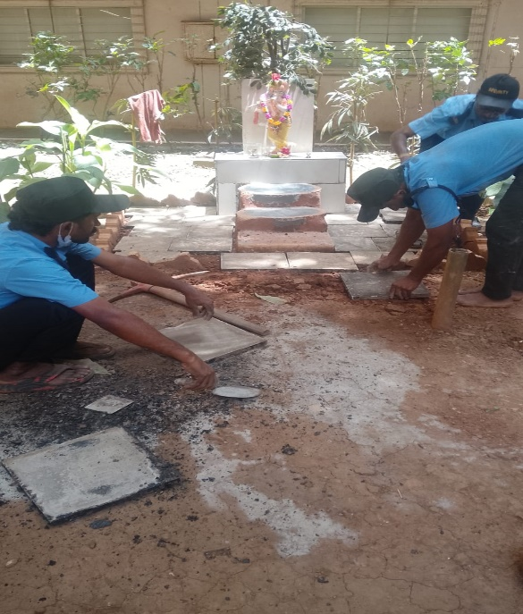
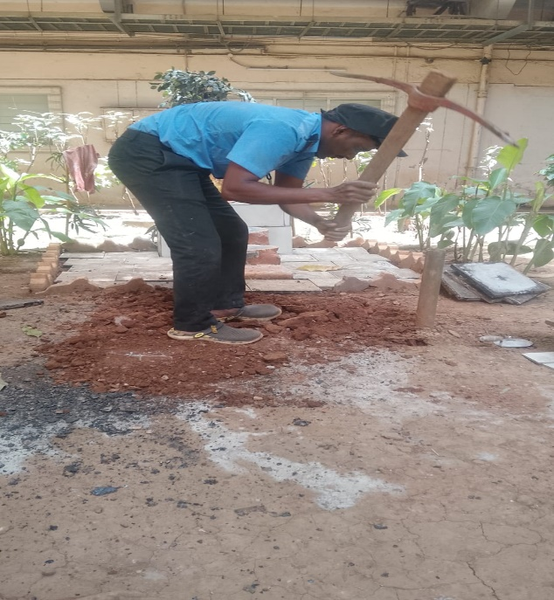
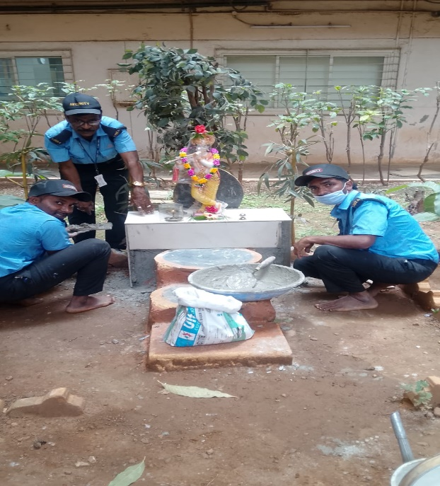
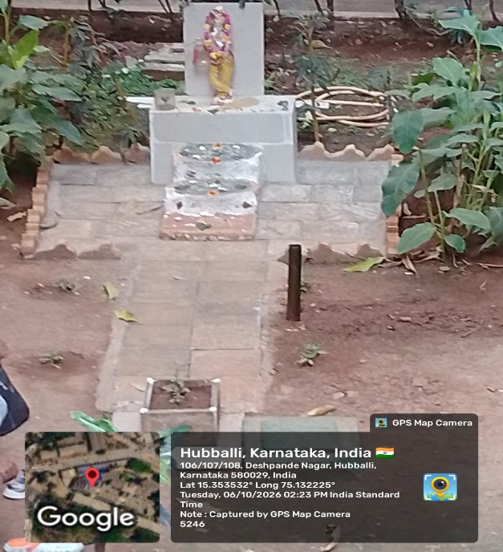
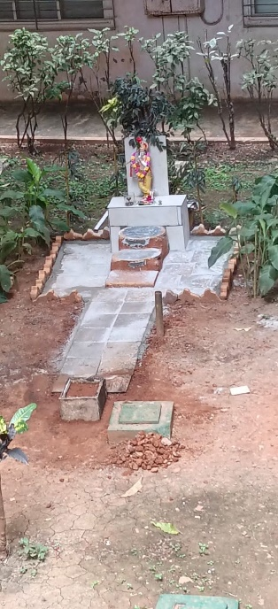
BEAUTIFICATION WORK AT SHRI KRISHNA SANNIDHANA BY SECURITY STAFF TILE & FOOTPATH WORK

Slide 13
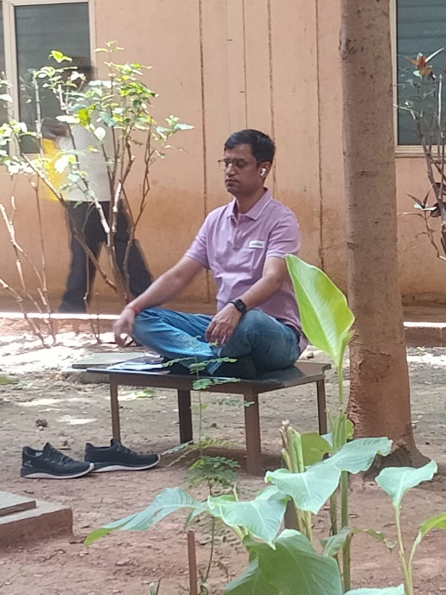
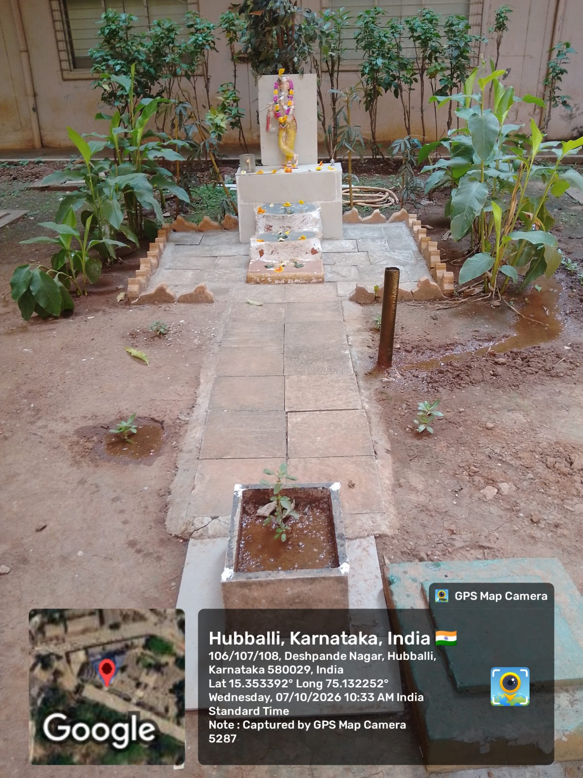
DIVINE IMPACT - A MEDITATION ZONE CREATED
• At the newly established Shri Krishna Sannidhana, an IT Park visitor came and sat in deep meditation.
• He was in complete peace and sat continuously for 1 hour in that divine atmosphere.
• The place which was once an unhygienic spitting zone is now transformed into a Peaceful Meditation Corner.
• This proves that - Where there is Divinity, there is Cleanliness and Peace. Where Notices Failed, Divinity Succeeded.

Slide 14
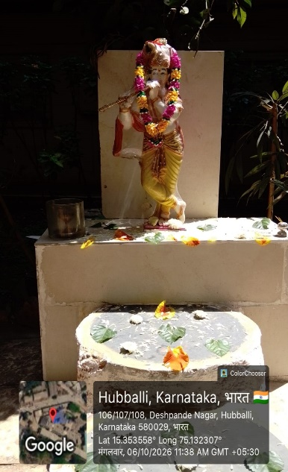
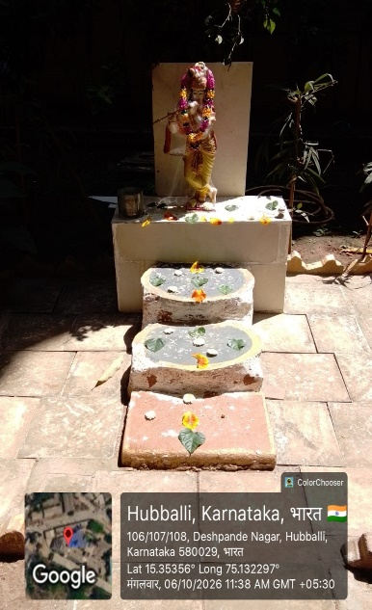
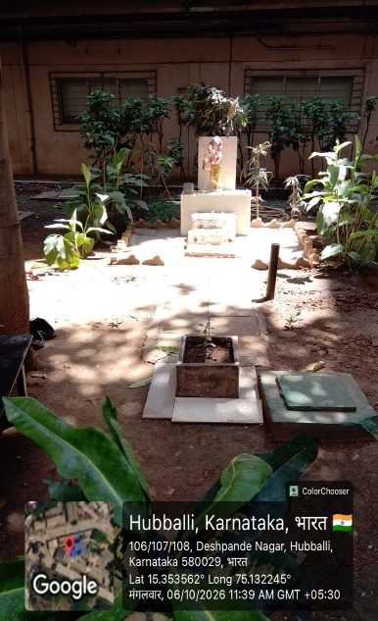
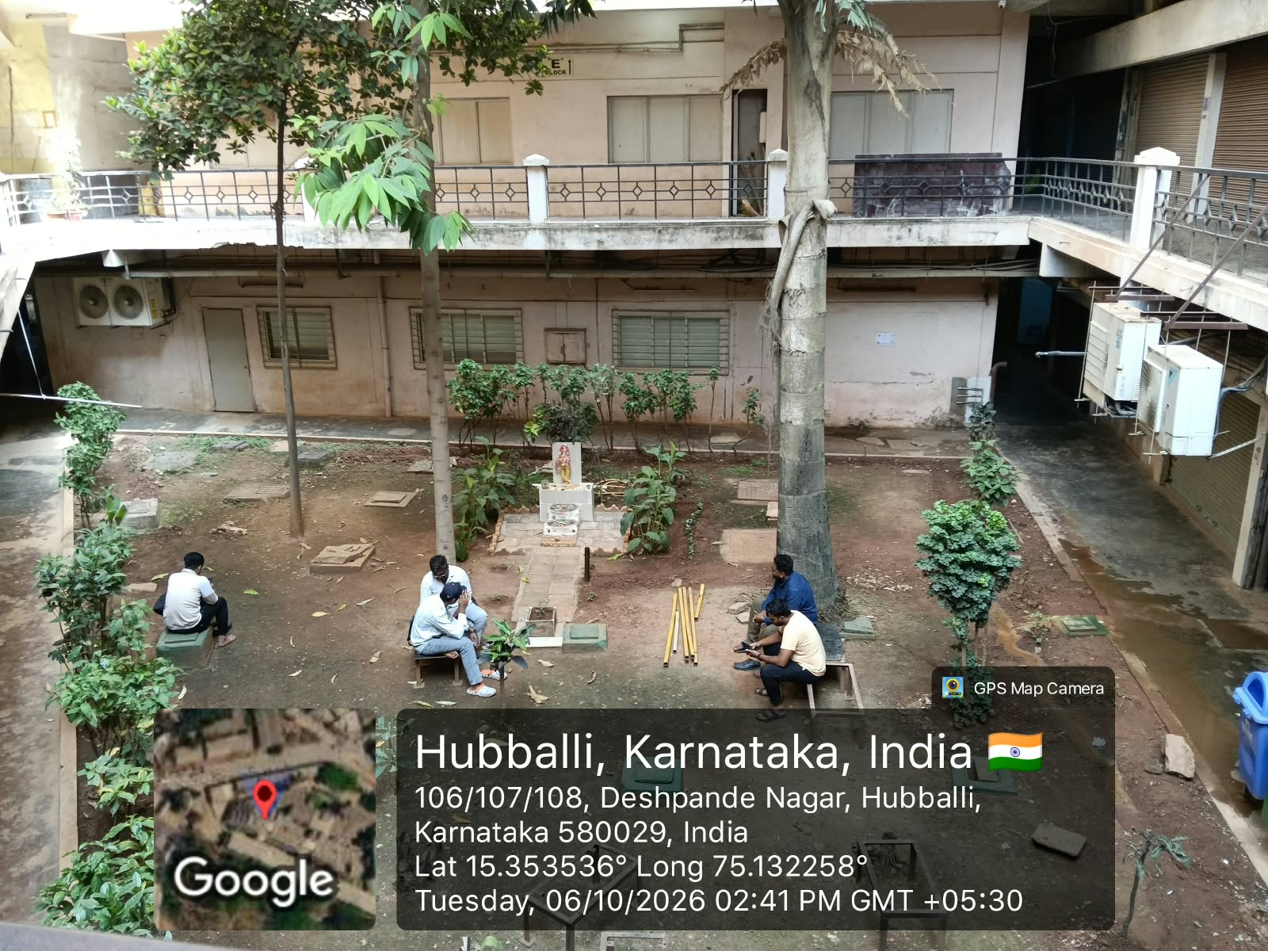
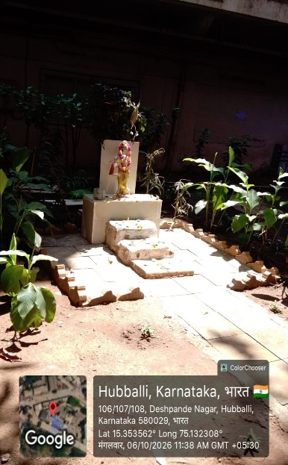
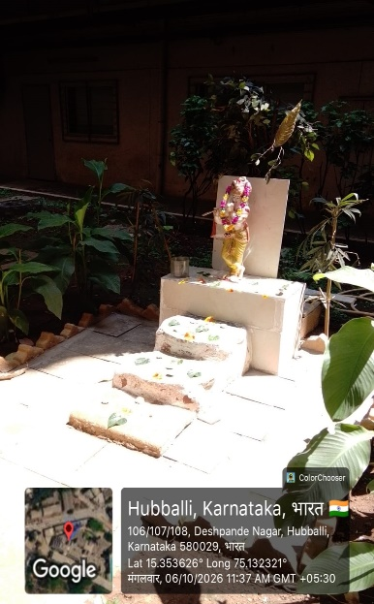
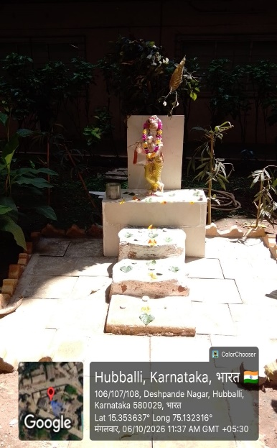
Area cleaned and decorated - Became Divine

Slide 15
SPACE UTILIZATION SUCCESS: Before Tile Work vs After Complete Development
BEFORE TILE WORK (Without Krishna):
• Ground was muddy, uneven and not suitable for sitting.
• No tiles, no seating arrangement, completely unutilized space.
AFTER ALL WORK (People Resting):
• After plantation, cleaning and tile development, area became clean & beautiful.
• Now IT Park staff and visitors are coming, sitting peacefully and taking rest .

Slide 16
FINAL OUTCOME: From Spitting Zone to Peaceful Meditation Zone - 100% Controlled
OUTCOME: DIVINE TRANSFORMATION SUCCESSFUL
• Earlier uncontrollable spitting, littering & unhygienic practices are now 100% under control.
• The place where people used to spit Gutkha & Paan has now become a Divine and Peaceful Corner.
• Now people come there, sit peacefully and do meditation (Dhyana) with calm mind.
• Visitors and staff sit near Lord Krishna, feel positivity and inner peace.
• A Spitting Zone has been transformed into a Meditation Zone - A True Success of Bhaya-Bhakti Concept.
FINAL OUTCOME: An Unused Muddy Area is Now a Clean, Green and Useful Public Relaxation Zone - Maintained by Security Team.

Slide 17
NEXT INITIATIVE: SHRI KRISHNA SANNIDHANA MANTAPA - Effort by Security Team
FUTURE PLAN - MANTAPA CONSTRUCTION WITH WASTE RESOURCES
Initiative by Security Team:
• Security guards are now putting effort to build a small Mantapa (Roof/Shelter) over Shri Krishna Sannidhana.
Use of Waste Resources - Zero Cost Concept:
• No new purchase - Using unused / waste resources already available in IT Park.
• Small iron pieces, waste iron rods and scrap materials are collected and kept ready.
• Collected waste materials will be re-used to fabricate the Mantapa structure.
Purpose:
• To protect Shri Krishna Idol from direct sunlight & rain.
• To give a complete divine and temple-like look to the Sannidhana.
• To show that waste can be converted into useful divine structure.
Status:
Material Collection Done - Work in Progress.

Slide 18
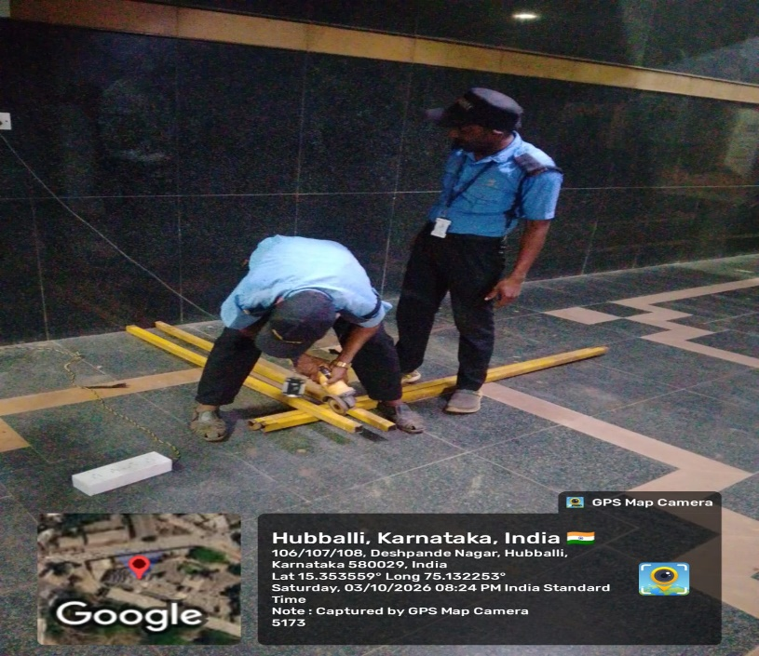
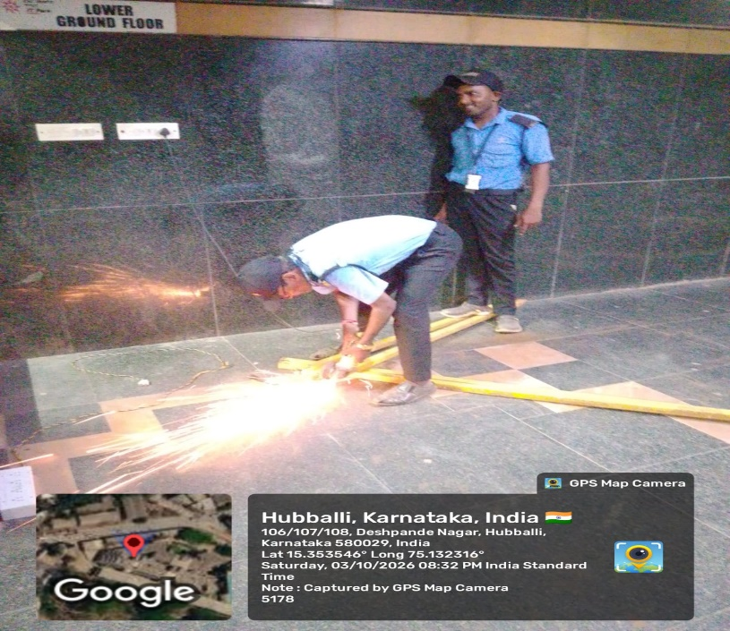
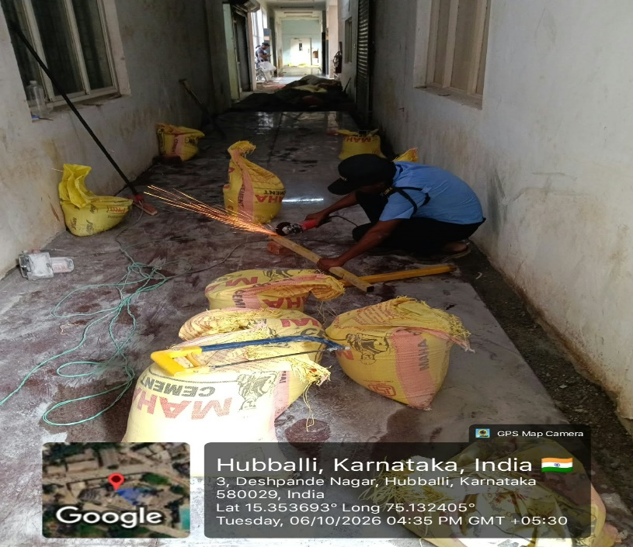
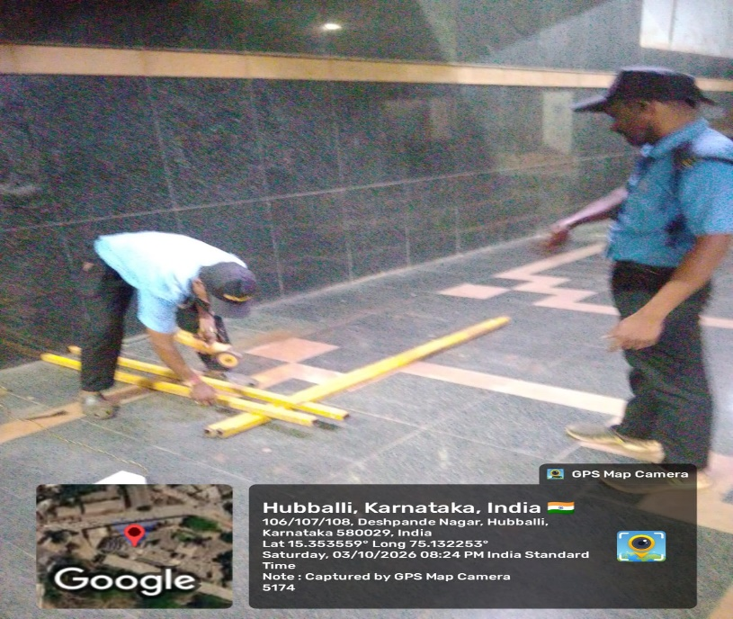
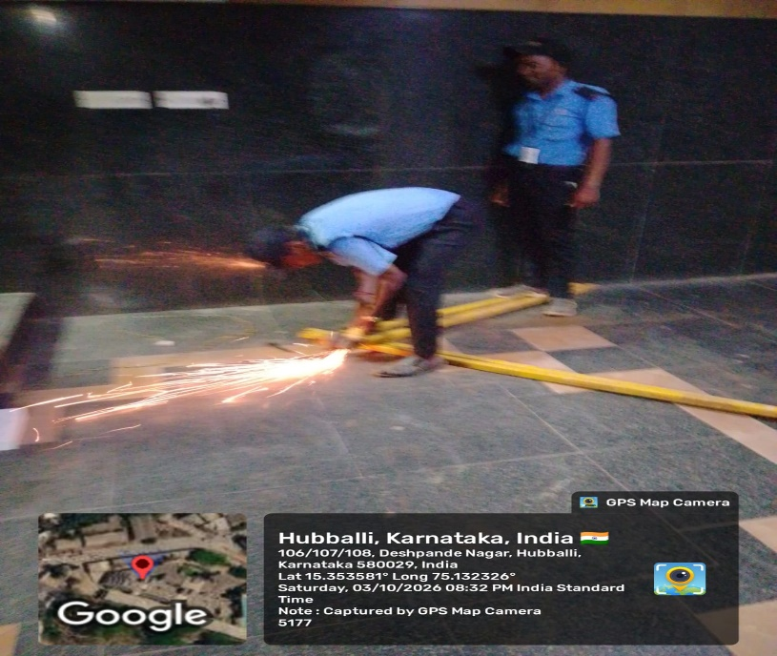
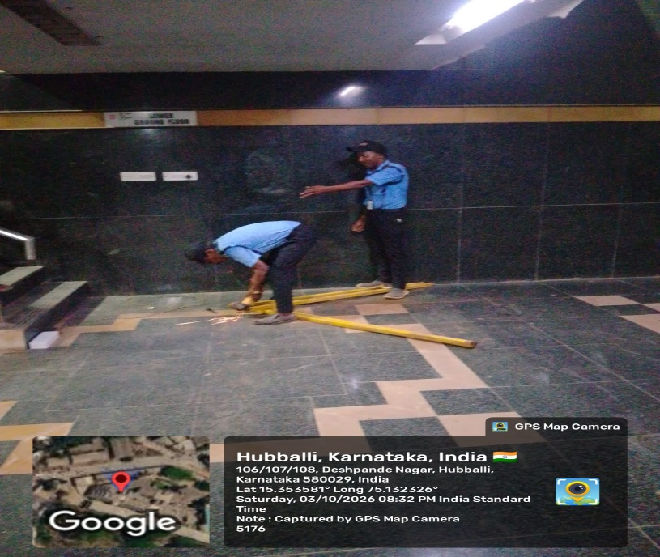
Photo: Waste iron pieces collected and kept at site - Proof of initiative.

Slide 19
THANK YOU FOR WATCHING

